Slide 1

CSE408
Design and analysis of
algorithms
Lecture #0

Slide 2
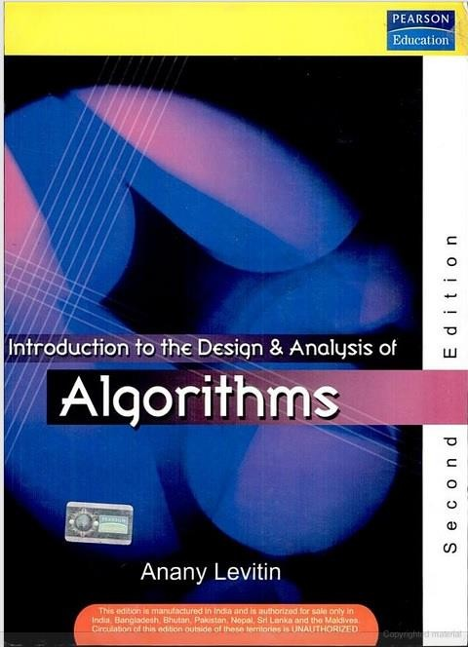
Course details
LTP – 1 0 0 [One lectures/week] [Credit: 3]
(Self Learning Mode)
Text Book
INTRODUCTION TO THE DESIGN AND ANALYSIS OF ALGORITHMS
ANANY LEVITIN,
PEARSON EDUCATION

Slide 3

(Course Assessment Model)
Marks break up*
Attendance 5
CA 25
3 Code Based Tests (Total 3 tasks, 2 best out of 3 to be considered)
MTE (MCQ) 20
ETE (MCQ) 50
Total 100

Slide 4
Detail of Academic Tasks
AT1: | Test1 | Before MTE
AT2: | Test2 | Before MTE
AT3: | Test3 | After MTE

Slide 5
Why we need to study this course ?

Slide 6
Why are we learning Design and analysis of algorithms?
Algorithms are used in almost every program or software system.
Once we design an algorithm we need to know how well it performs on any input.
In particular we would like to know whether there are better algorithms for the problem, An answer to this first demands a way to analyze an algorithm in a machine-independent way.
Some Specific design techniques are essential ingredients of
many software applications.

Slide 7
The course contents CSE408
UNIT I - Foundations of algorithm
UNIT II - String matching algorithms and computational geometry
UNIT III - Divide and conquer and ordered statists
UNIT IV - Dynamic programming and greedy techniques
UNIT V - Approximation algorithms
UNIT VI - Number-theoretic algorithms and complexity classes

Slide 8

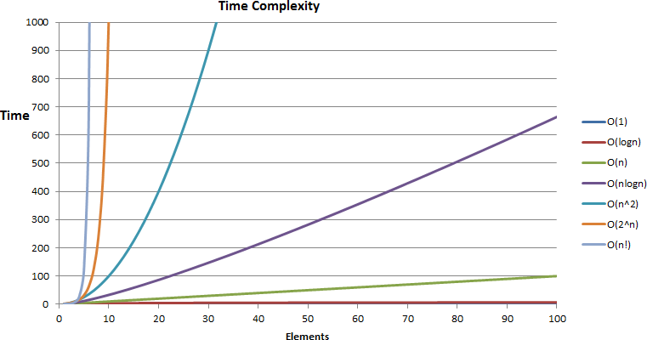


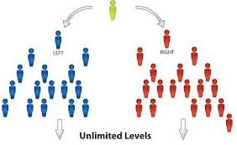
UNIT I
Foundations of algorithm
Basic DS
Analysis and growth

Slide 9
UNIT-1
Analysis of algorithm:
History and Motivation
A Scientific Approach, Example: Quicksort
Introductions to "big-oh" notation and asymptotic analysis.
Recurrence relations :
Computing Values
Telescoping
Types of Recurrences
Mergesort
Master Theorem .
Overview of generating functions:
Ordinary Generating Functions
Counting with Generating Functions
Catalan Numbers,
Solving Recurrences
Exponential Generating Functions
Asymptotics:
Standard Scale
Manipulating Expansions
Asymptotics of Finite Sums
Asymptotics of Finite Sums
Trees:
Trees and Forests
Binary Search Trees
Path Length
Other Types of Trees.
Link of Coursera:-
https://www.coursera.org/learn/analysis-of-
algorithms

Slide 10

UNIT II
String matching algorithms and computational geometry

Slide 11
UNIT-2
Strings and Tries:
Bitstrings with Restrictions
Languages
Tries
Trie Parameters Key pattern matching concepts:
Suffix Tree
Suffix Array
Knuth-Morris-Pratt algorithm .
Link of Coursera:-
https://www.coursera.org/learn/algorithms-on-
strings

Slide 12
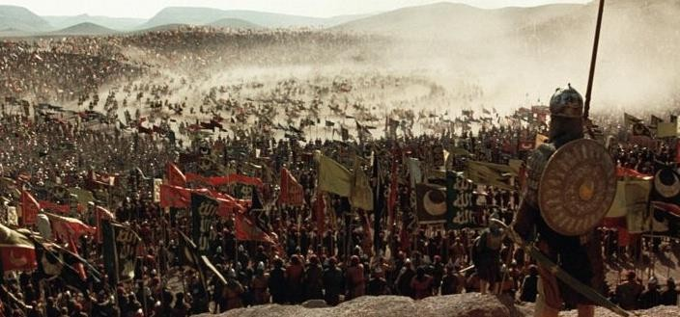
UNIT III
Divide and conquer and ordered statists

Slide 13
UNIT-3
What Are Divide and Conquer Algorithms?
Max Subarray Problem Using Divide and
Conquer
Karatsuba’s Multiplication Algorithm
FFT Part 1: Introduction and Complex Numbers
FFT Definition and Interpretation of Discrete Fourier Transforms
FFT: Divide and Conquer Algorithm for FFT Application
# 1 : Fast Polynomial Multiplication using
FFT Application
# 2: Data Analysis using FFT
Link of Coursera
https://www.coursera.org/learn/dynamic-
programming-greedy-algorithms#modules

Slide 14


UNIT IV
Dynamic programming and greedy technique
Dynamic programming(Knap sack)
Greedy technique

Slide 15
Greedy technique
B
8
C
2
3
3
1
S
2
D
5
9
A
E
7
Shortest Distance=?

Slide 16
Dynamic programming
B
8
C
2
3
3
1
S
2
D
5
9
A
E
7
Shortest Distance=?

Slide 17
UNIT-4
Introduction to Dynamic Programming + Rod Cutting Problem
Coin Changing Problem
Knapsack Problem
When Optimal Substructure Fails
Dynamic Programming: Longest Common
Link of Coursera
Subsequence
Memoization
Coin Changing Problem.
Introduction to Greedy Algorithms
Greedy Interval Scheduling
Prefix Codes
Huffman Codes
Huffman Codes: Proof of Optimality
https://www.coursera.org/learn/dynamic-
programming-greedy-algorithms#modules

Slide 18

UNIT V
Backtracking and approximation algorithms

Slide 19
UNIT-5
Introduction to Approximation Algorithms
Introduction to Job shop Scheduling and Algorithm Design
Analysis of Job shop Scheduling
Approximation Algorithms for Vertex Cover and their Analysis,
Approximation Algorithms for the Maximum Satisfiability Problem
Travelling Salesman Problem
Approximation Schemes: Introduction to TSP and its applications
NP-Hardness of TSPs
Hardness of Approximating General TSPs
Link of Coursera
https://www.coursera.org/learn/linear-
programming-and-approximation-
algorithms#modules

Slide 20

UNIT VI
Number-theoretic algorithms and complexity classe

Slide 21
UNIT-6
Decision Problems and Languages
Polynomial Time Problems
NP Definition
NP Completeness and Reductions
NP Complete Problems: Examples
Computation and Physics Qubits and
Link of coursera
Operations
Bell's Inequality
Grover's Search Algorithm
https://www.coursera.org/learn/dynamic-
programming-greedy-algorithms#modules

Slide 22
It is mandatory to complete the number of course for being eligible for End Term Examination along with the attendance criteria of the university. The links of the courses as shared in the IP should be completed on/before the last teaching day as per the academic calendar of the university.

Slide 23
What will be the course outcome?
CO1: Understand the basic techniques of analyzing the algorithms using space and time
complexity, asymptotic notations
CO2: Apply the various string matching algorithms
CO3: Analyze the divide and conquer algorithm design technique using various searching and sorting algorithms
CO4: Evaluate the various dynamic programming and greedy algorithm design technique to solve various problems
CO5: :Apply the backtracking method to solve some classic problems and understand
branch and bound algorithm design technique
CO6: Define Number-Theoretic Algorithms and Complexity Classes and understand the basics concepts of complexity classes

Slide 24
What will be the Program outcome?
PO1::Apply the knowledge of mathematics, science, engineering fundamentals, and
an engineering specialization to the solution of complex engineering problems.
PO2::Identify, formulate, review research literature, and analyse complex engineering problems reaching substantiated conclusions using first principles of mathematics, natural sciences and engineering sciences.
PO3::Design solutions
for complex engineering problems and design system
components or processes that meet the specified needs with appropriate consideration for the public health and safety, and the cultural, societal, and environmental considerations.
PO4::Use research-based knowledge and research methods including design of experiments, analysis and interpretation of data, and synthesis of the information to provide valid conclusions.

Slide 25
PO5::Create, select , and apply appropriate techniques, resources, and modern engineering and IT tools including prediction and modelling to complex engineering activities with an understanding of the limitations.
PO6::Apply reasoning informed by the contextual knowledge to assess societal , health, safety, legal and cultural issues and the consequent responsibilities relevant to the professional engineering practice.
PO7::Understand the impact of the professional engineering solutions in societal and environmental contexts, and demonstrate the knowledge of, and need for sustainable development.
PO8::Apply ethical principles and commit to professional ethics and responsibilities and norms of the engineering practice.

Slide 26
PO9::Function effectively as an individual, and as a member or leader in diverse
teams, and in multidisciplinary settings .
PO10::Communicate effectively on complex engineering activities with the engineering community and with society at large, such as, being able to comprehend and write effective reports and design documentation, make effective presentations, and give and receive clear instructions.
PO11::Demonstrate knowledge and understanding of the engineering and management principles and apply these to one’s own work, as a member and leader in a team, to manage projects and in multidisciplinary environments.
PO12::Recognize the need for, and have the preparation and ability to engage in independent and lifelong learning in the broadest context of technological change.

Slide 27
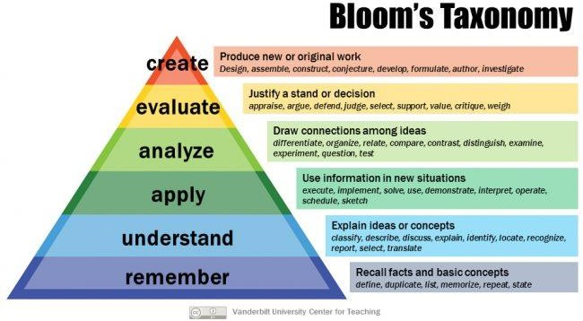

Slide 28
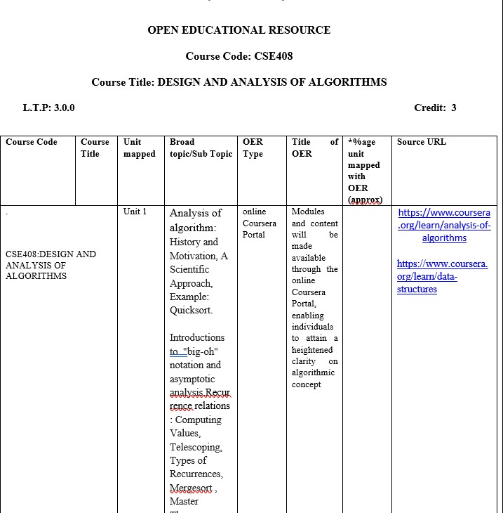
OER(OPEN EDUCATIONAL RESOURCE)

Slide 29
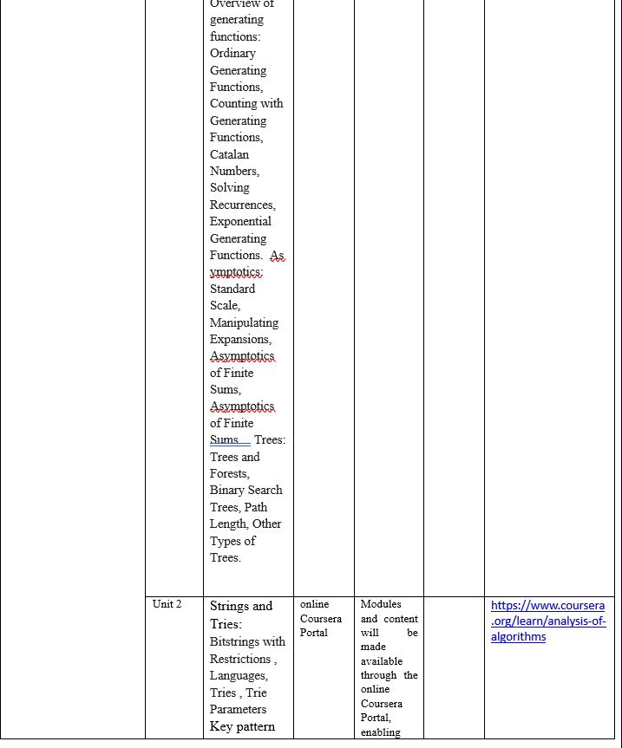

Slide 30
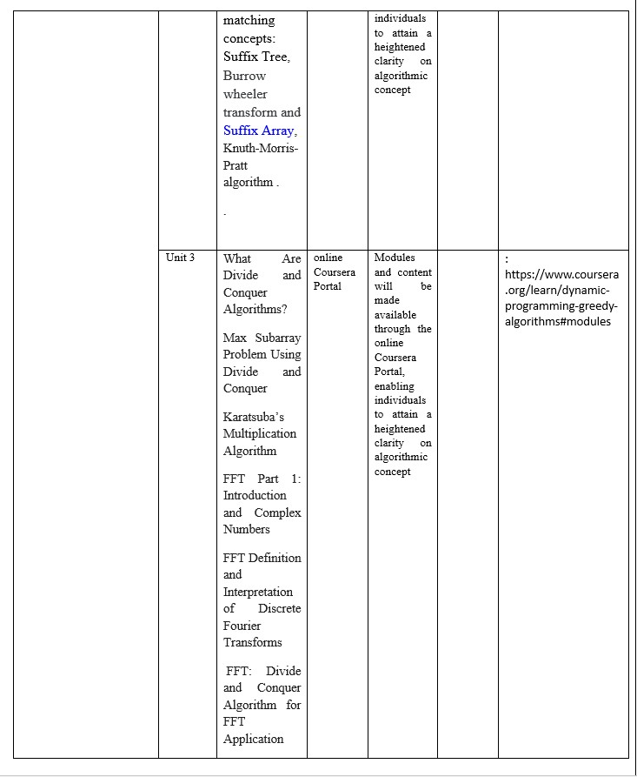

Slide 31
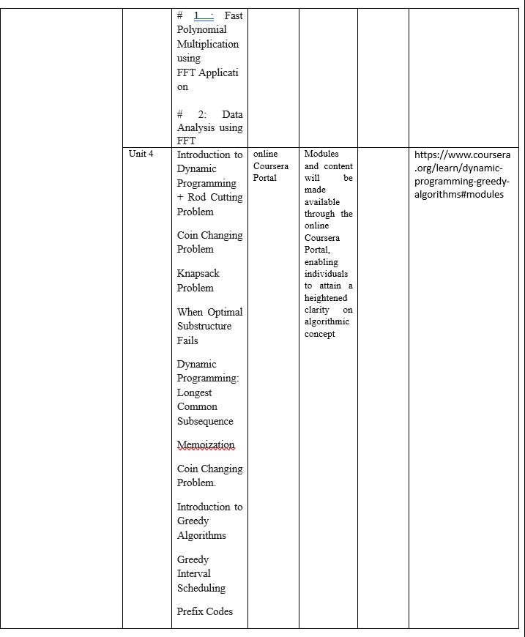

Slide 32
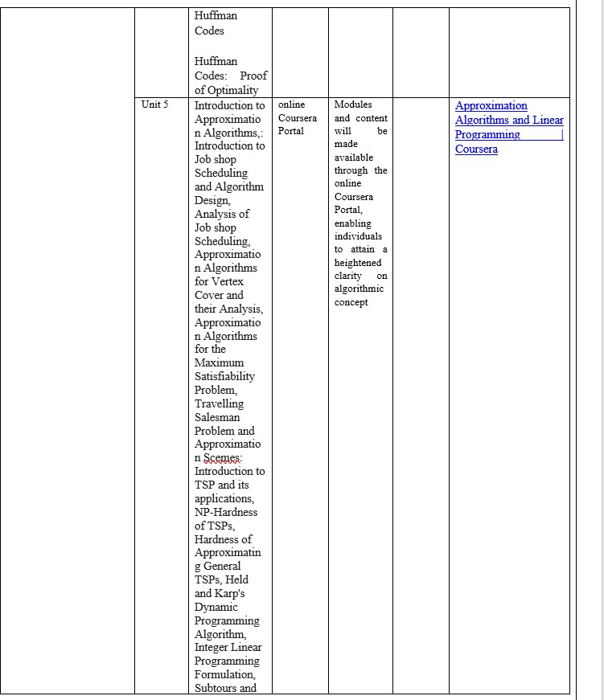

Slide 33
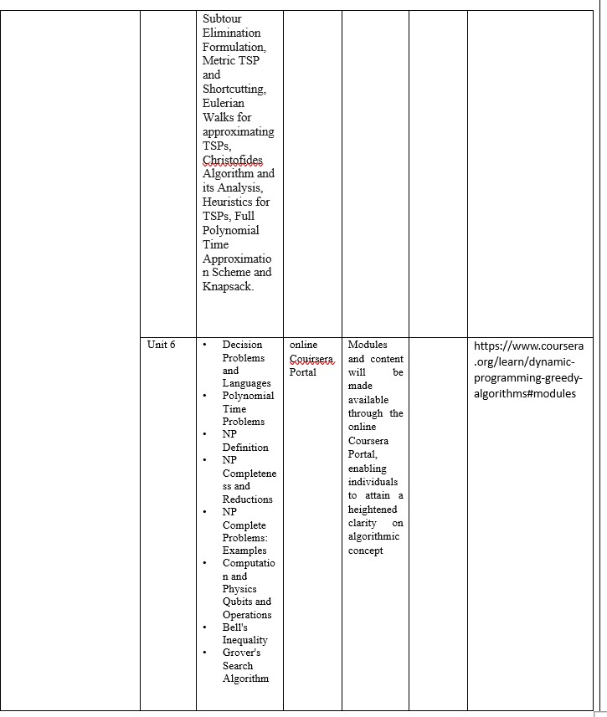

Slide 34

Let’s Start: Foundations of algorithm

